Slide 1

Achieving Long-term Fairness in Sequential Decision Making
Yaowei Hu (yaoweihu@uark.edu)
Lu Zhang (lz006@uark.edu)
University of Arkansas

Slide 2
Fair Machine Learning
Fair machine learning plays an important role in decision making
tasks such as hiring, college admissions and bank loans.
Various fairness notions: demographic parity, equalized odds and counterfactual fairness.
However, the majority of studies on fair machine learning focus
on the static or one-shot classification setting.

Slide 3


Decision Making Systems Are Dynamic
In practice, decision making systems are usually operating in
a dynamic manner such that the classifier makes sequential
decisions over a period of time.
Example:
The bank uses the applicants’ credit
scores to make loan decisions
Loan
The bank’s decisions will affect the
applicants’ credit scores
Feedback Loop

Slide 4
Long-term Fairness
Fair decision making should concern not only the fairness of a single decision but more importantly, whether a decision model can impose fair long-term effects on different groups.
This notion of fairness is referred to as long-term fairness in recent studies.

Slide 5
The Challenges
The challenges of achieving long-term fairness:
Feedback Loop. Without knowing how the population would be reshaped
by decisions, enforcing any fairness constraint may create negative feedback
loops and eventually harm fairness in the long run.
Distribution Shift. Ignoring the distribution shift will critically affect the
achievement of long-term fairness, as long-term fairness is affected by all
decisions made by the model along the time.

Slide 6
Main Contributions
We propose a causality-based long-fairness notion.
We propose a framework for formulating long-term fair sequential decision making as performative risk optimization problem.
Experiments on both synthetic and real-world datasets show that the proposed method can achieve long-term fairness in multiple time steps.

Slide 7
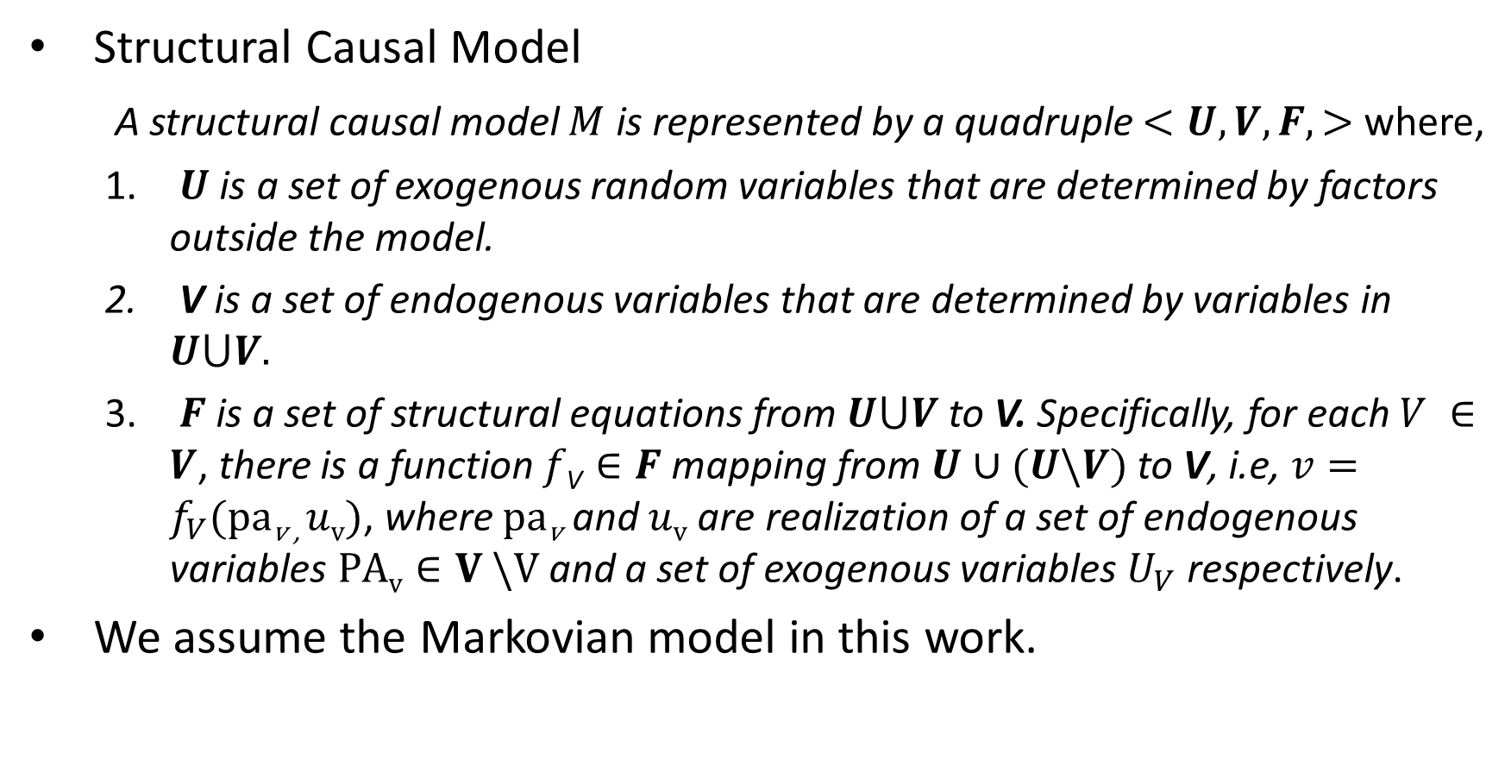
Preliminaries
Structural Causal Model
A structural causal model $M$ is represented by a quadruple $<U, V, F, >$ where,
$U$ is a set of exogenous random variables that are determined by factors outside the model.
V is a set of endogenous variables that are determined by variables in $U⋃V.$
$F$is a set of structural equations from $U⋃V$to V. Specifically, for each $V ∈V$, there is a function $f\text{V}∈F$ mapping from $U∪(U\backslash V)$ to V, i.e, $v=f_{V}(pa\text{v}\text{ , }uv)$, where $pa\text{v}$ and $uv$ are realization of a set of endogenous variables $PAv∈V \backslash V$ and a set of exogenous variables $U_{V}$ respectively.
We assume the Markovian model in this work.

Slide 8
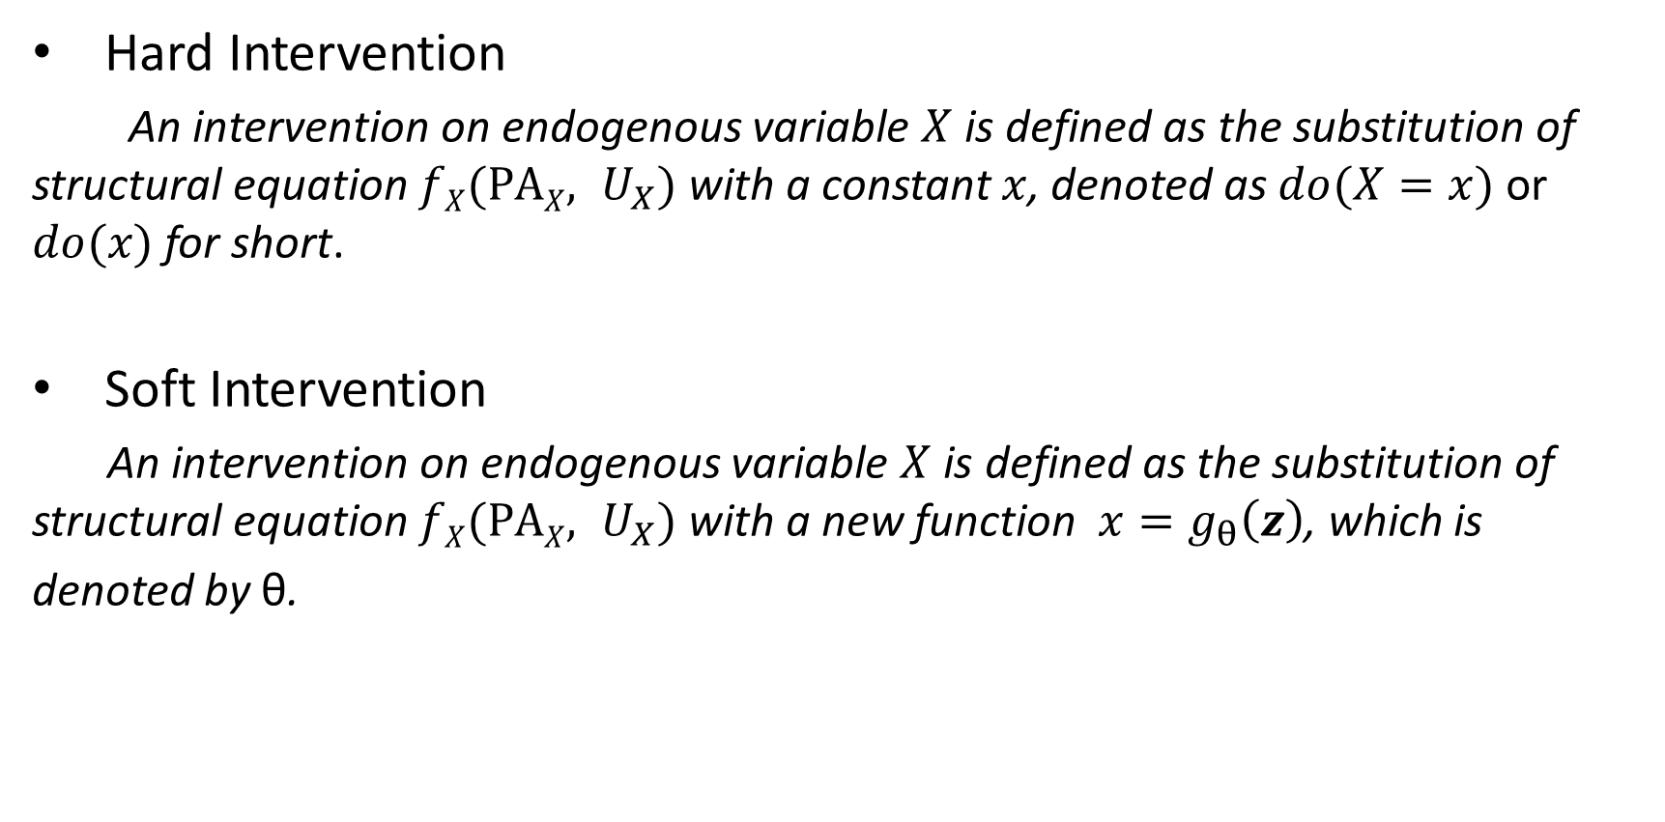
Preliminaries
Hard Intervention
An intervention on endogenous variable $X$ is defined as the substitution of structural equation $fX(PAX, U_{X})$ with a constant $x$, denoted as $do(X=x)$ or $do(x)$ for short.
Soft Intervention
An intervention on endogenous variable $X$ is defined as the substitution of structural equation $fX(PAX, U_{X})$ with a new function $x=g_{θ}\left(z\right)$, which is
denoted by θ.

Slide 9
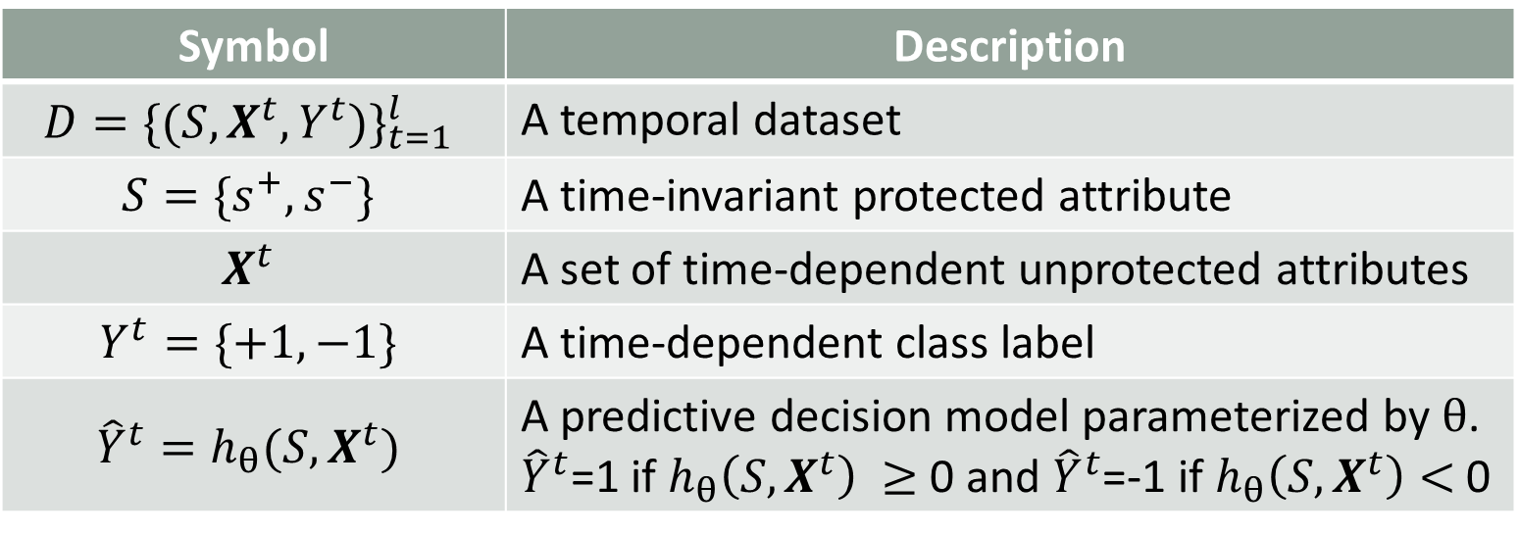
Notation Table
Symbol | Description
$$D{=\{(S, X^{t}, Y^{t})\}}_{t=1}^{l}$$ | A temporal dataset
$$S=\{s^{+},s^{−}\}$$ | A time-invariant protected attribute
$$X^{t}$$ | A set of time-dependent unprotected attributes
$$Y^{t}=\{+1, −1\}$$ | A time-dependent class label
$${\hat{Y}}^{t}=h_{θ}(S, X^{t})$$ | A predictive decision model parameterized by $θ$. ${\hat{Y}}^{t}$=1 if $h_{θ}\left(S, X^{t}\right) ≥$0 and ${\hat{Y}}^{t}$=-1 if $h_{θ}\left(S, X^{t}\right)<$ 0

Slide 10
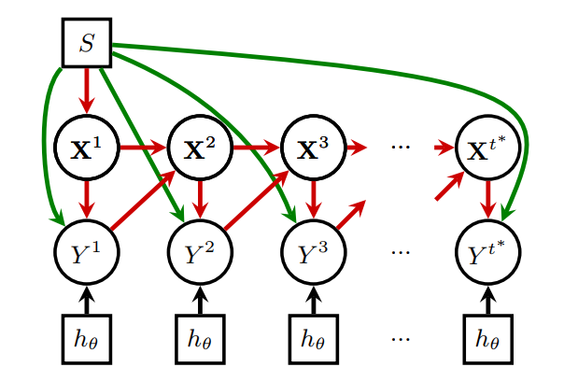
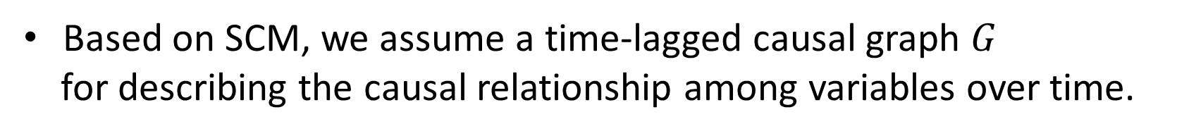
Causality-based Long-term Fairness
Based on SCM, we assume a time-lagged causal graph $G$
for describing the causal relationship among variables over time.

Slide 11
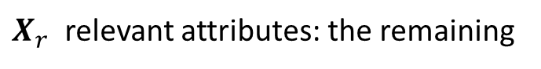
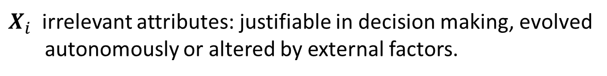

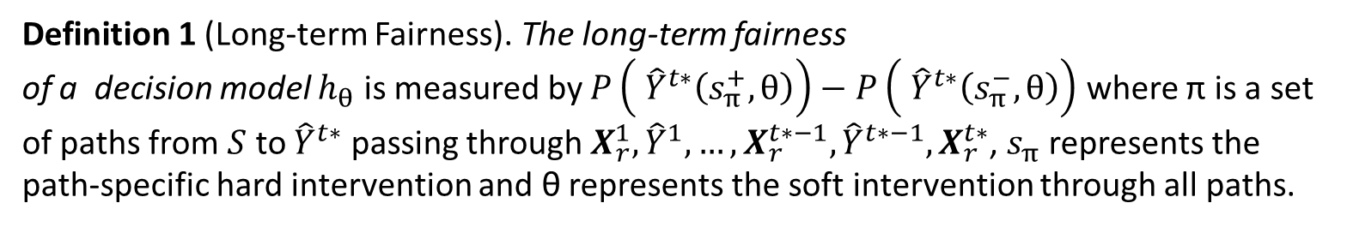
Causality-based Long-term Fairness
long-term fairness. Formulated as path-specific effects that are
transmitted in the time-lagged causal graph along certain paths.
$X_{i}$ irrelevant attributes: justifiable in decision making, evolved
autonomously or altered by external factors.
$$X$$
$X_{r}$ relevant attributes: the remaining
Definition 1 (Long-term Fairness). The long-term fairness
of a decision model $h_{θ}$ is measured by $P\left( {\hat{Y}}^{t∗}\left(s_{π}^{+}, θ\right)\right)−P\left( {\hat{Y}}^{t∗}\left(s_{π}^{−}, θ\right)\right)$ where π is a set of paths from $S$ to ${\hat{Y}}^{t∗}$ passing through $X_{r}^{1},{\hat{Y}}^{1}, …,X_{r}^{t∗−1},{\hat{Y}}^{t∗−1},X_{r}^{t∗}$, $s_{π}$ represents the path-specific hard intervention and θ represents the soft intervention through all paths.

Slide 12
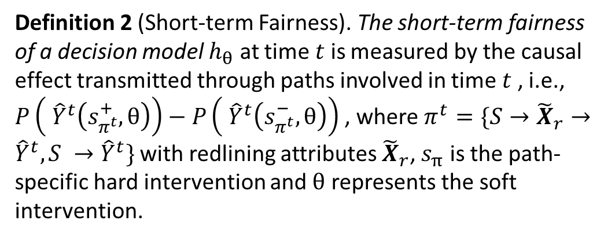
Loss Function and Short-term Fairness
Two other requirements:
- Short-term Fairness. The decision model should also satisfy certain
short-term fairness requirement at each time step to enforce local equality,
which may be stipulated by law or regulations.
Definition 2 (Short-term Fairness). The short-term fairness of a decision model $h_{θ}$ at time $t$ is measured by the causal effect transmitted through paths involved in time $t$ , i.e., $P\left( {\hat{Y}}^{t}\left(s_{π^{t}}^{+}, θ\right)\right)−P\left( {\hat{Y}}^{t}\left(s_{π^{t}}^{−}, θ\right)\right)$ , where $π^{t}=\{S→{\tilde{X}}_{r}→{\hat{Y}}^{t}, S →{\hat{Y}}^{t}\}$ with redlining attributes ${\tilde{X}}_{r}$, $s_{π}$ is the path-specific hard intervention and $θ$ represents the soft intervention.

Slide 13
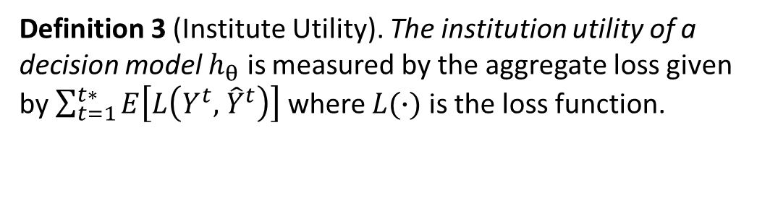
Loss Function and Short-term Fairness
Two other requirements:
- Institution Utility. It is a natural desire for a predictive decision model to
maximize the institution utility.
Definition 3 (Institute Utility). The institution utility of a decision model $h_{θ}$ is measured by the aggregate loss given by $\sum_{t=1}^{t∗}{E\left[L\left(Y^{t},{ \hat{Y}}^{t}\right)\right]}$ where $L(∙)$ is the loss function.

Slide 14
Soft Intervention for Model Deployment
In all three definitions, we use soft intervention for modeling the decision model deployment.
We treat the deployment of the decision model at each time step as to perform a soft intervention on the decision variable.
The change to underlying population could be inferred as the post-intervention distribution after performing the soft intervention.

Slide 15
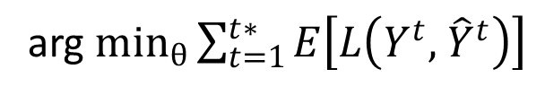
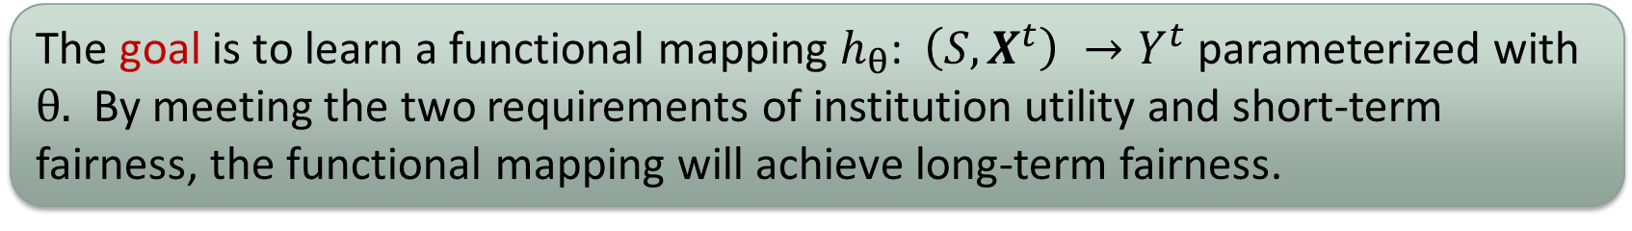
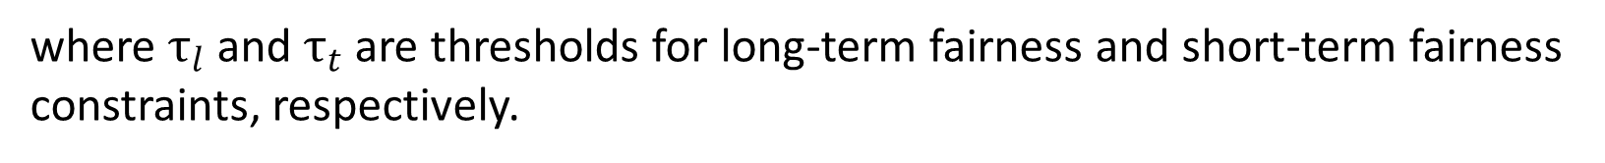
Learning Fair Decision Model
The goal is to learn a functional mapping $h_{θ}$: $\left(S, X^{t}\right) →Y^{t}$ parameterized with $θ.$ By meeting the two requirements of institution utility and short-term fairness, the functional mapping will achieve long-term fairness.
Problem Formulation 1. The problem of fair sequential decision making is formulated as the constrained optimization:
arg $\min_{θ}{\sum_{t=1}^{t∗}{E\left[L\left(Y^{t},{ \hat{Y}}^{t}\right)\right]}}$⁡
s.t. $P\left( {\hat{Y}}^{t∗}\left(s_{π}^{+}, θ\right)=1\right)−P\left( {\hat{Y}}^{t∗}\left(s_{π}^{−}, θ\right)=1\right)$ ≤ $τ_{l}$ ⁡
$P\left( {\hat{Y}}^{t}\left(s_{π^{t}}^{+}, θ\right)=1\right)−P\left( {\hat{Y}}^{t}\left(s_{π^{t}}^{−}, θ\right)=1\right)$ ≤ $τ_{t}$, $t=1, …, t^{∗}$
where $τ_{l}$ and $τ_{t}$ are thresholds for long-term fairness and short-term fairness constraints, respectively.

Slide 16
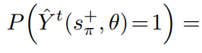
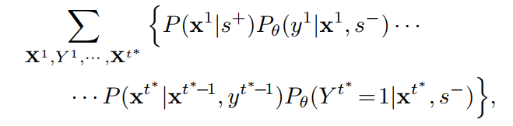
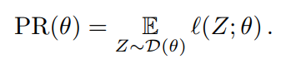
Performative Risk Optimization
Solving the optimization problem in Problem Formulation 1 is not trivial.
Convert Problem Formulation 1 to the form of performative risk optimization.
The general formulation of the performative risk optimization is

Slide 17
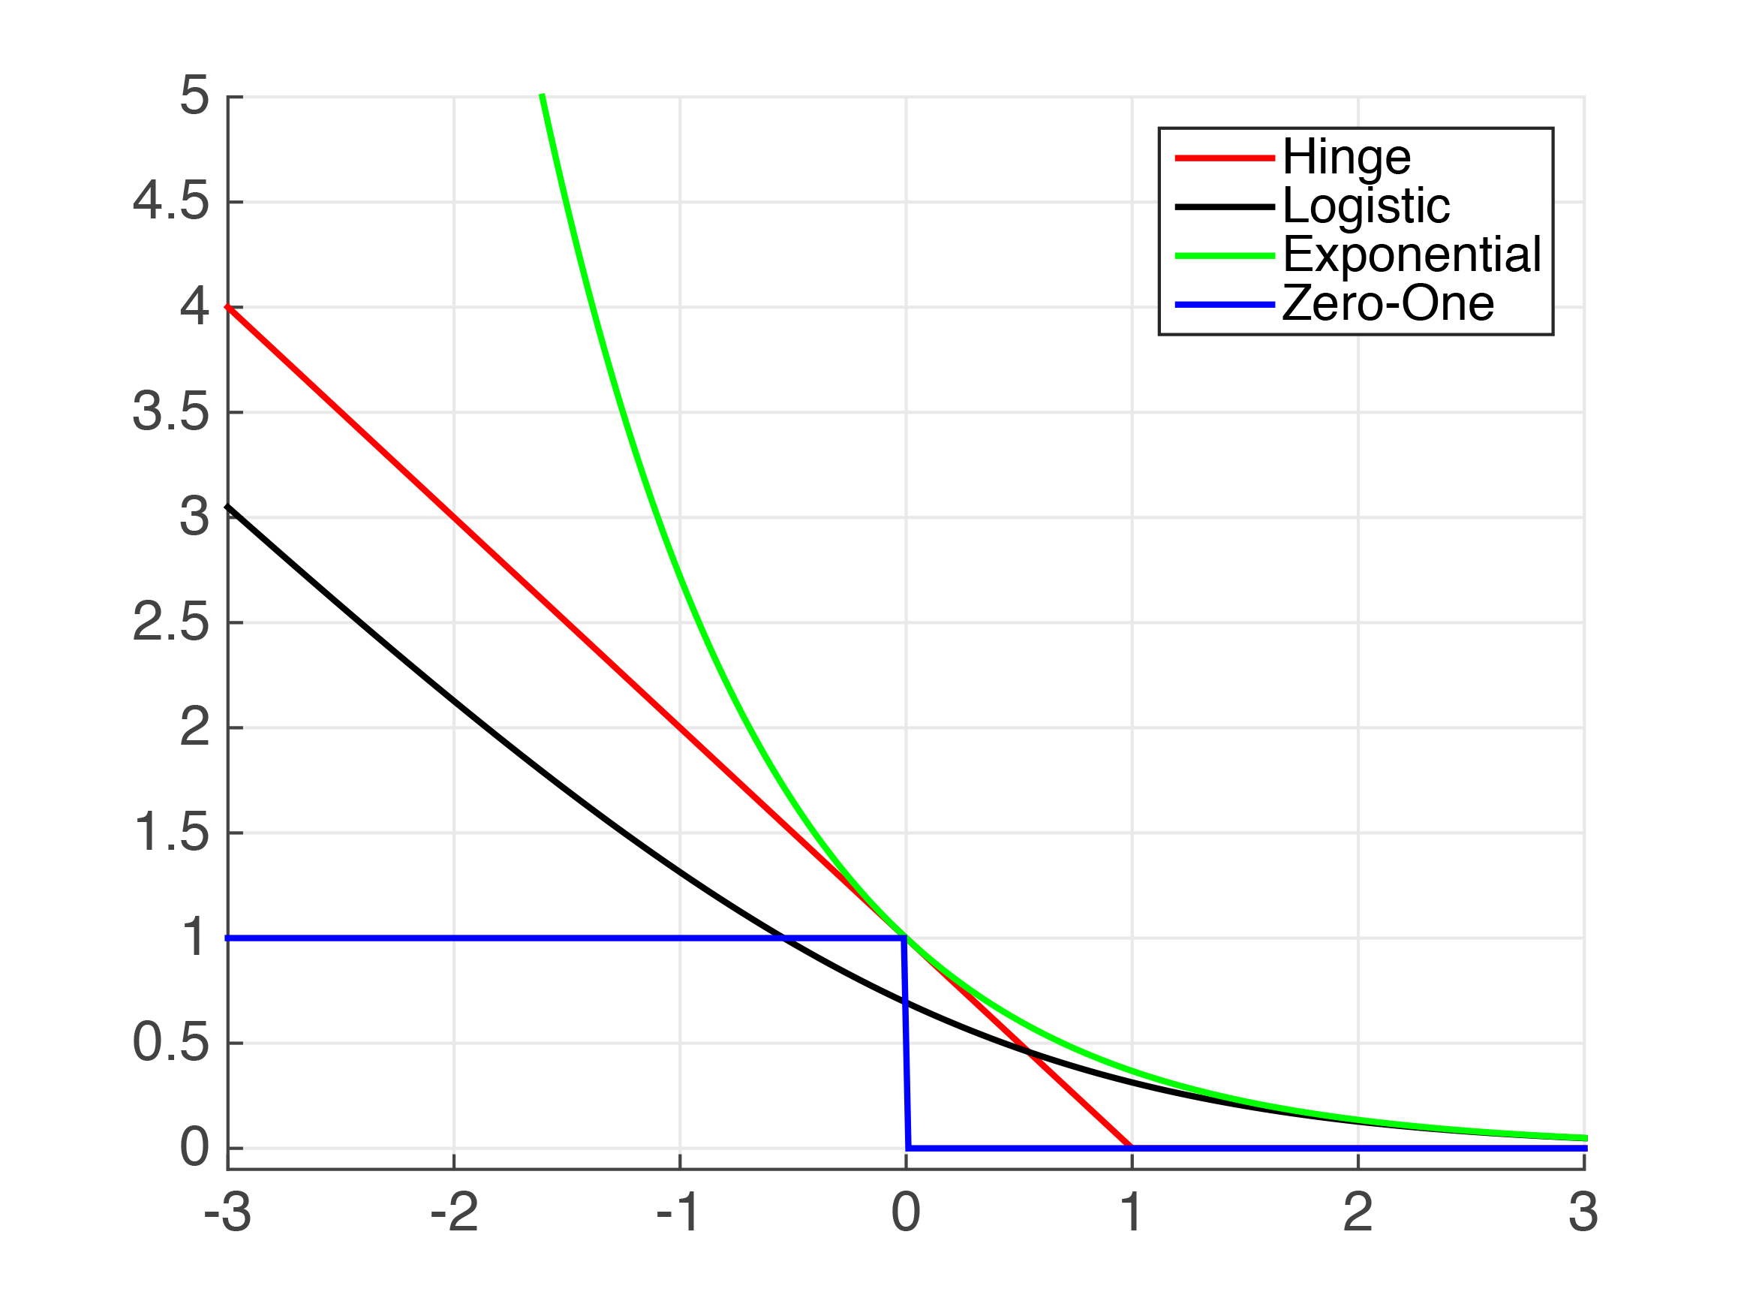
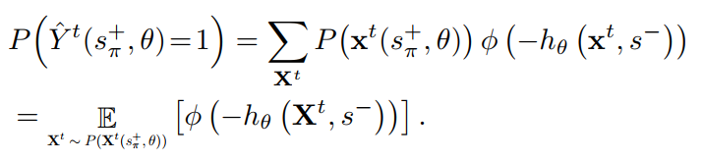
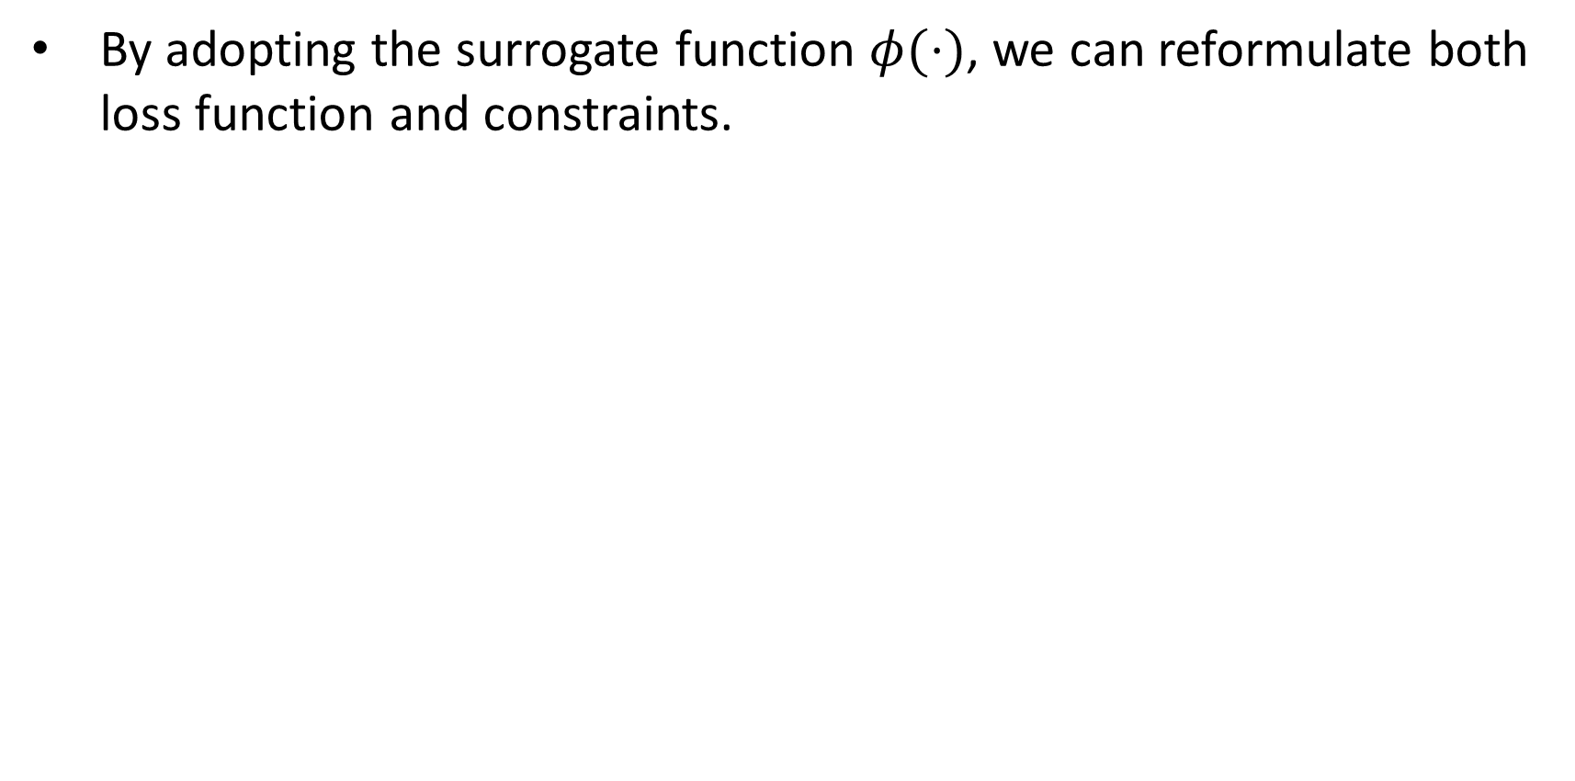
Performative Risk Optimization
By adopting the surrogate function $φ(⋅)$, we can reformulate both loss function and constraints.

Slide 18
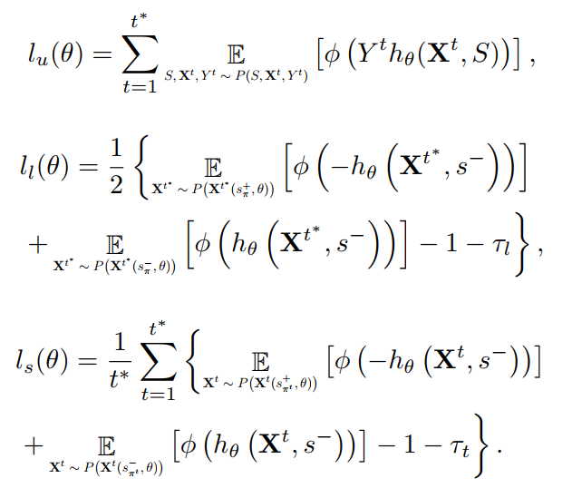
Performative Risk Optimization
Reformulate utility, short-term fairness and long-term fairness in the form of performative risk.

Slide 19
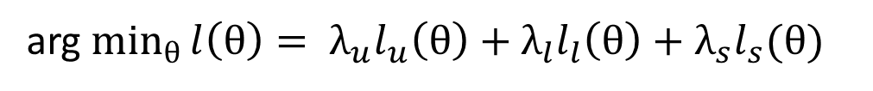
Performative Risk Optimization
Problem Formulation 2. The problem of fair sequential decision making is reformulated as the performative risk optimization:
arg $\min_{θ}{l\left(θ\right)= λ_{u}l_{u}\left(θ\right)+λ_{l}l_{l}\left(θ\right)+λ_{s}l_{s}(θ)}$⁡
where $λ_{u},λ_{l}$ and $λ_{s}$ are weight parameters and satisfy $λ_{u}+λ_{l}+λ_{s}=1.$

Slide 20
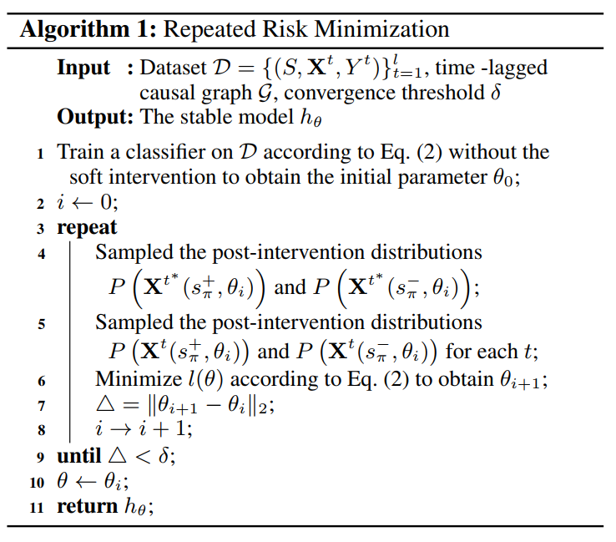
Repeated Risk Minimization
Repeated risk minimization (RRM) is an iterative algorithmic heuristic for
solving the performative risk optimization problem.

Slide 21
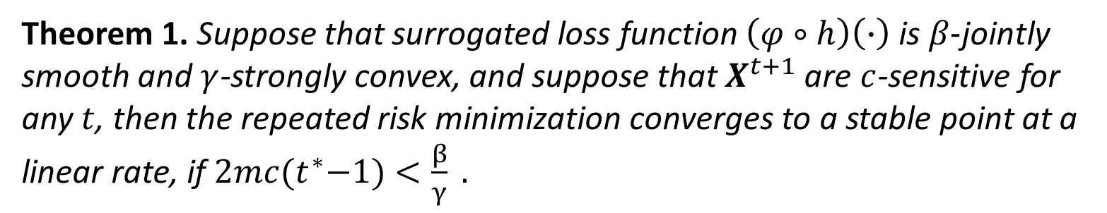
Convergence Analysis of RRM
The convergence of the RRM algorithm depends on the smoothness and convexity of the loss function, as well as the sensitivity of the distribution to the parameters.
Theorem 1. Suppose that surrogated loss function $\left(φ∘h\right)\left(∙\right)$ is $β−$jointly smooth and $γ$-strongly convex, and suppose that $X^{t+1}$ are $c$-sensitive for any$t$, then the repeated risk minimization converges to a stable point at a linear rate, if $2mc{(t}^{∗}−1)<\frac{β}{γ} .$

Slide 22
Experiments
Baselines:
Logistic Regression (LR): An unconstrained logistic regression model which takes user features and labels from all time steps as inputs and outputs.
Fair Model with Demographic Parity (FMDP): On the basis of the logistic regression model, fairness constraint is added to achieve demographic parity.
Fair Model with Equal Opportunity (FMEO): On the basis of the logistic regression model, fairness constraint is added to achieve equal opportunity.

Slide 23
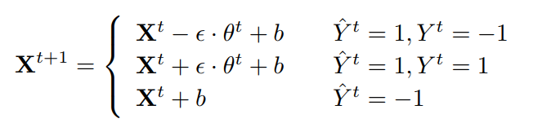
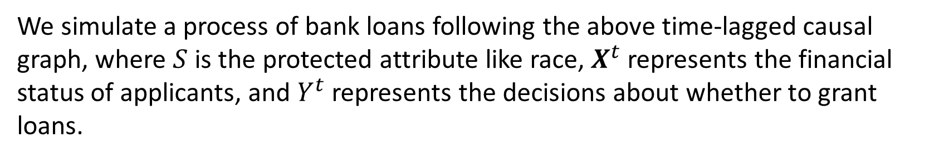
Experiments
Synthetic Data:
We simulate a process of bank loans following the above time-lagged causal graph, where $S$ is the protected attribute like race, $X^{t}$ represents the financial status of applicants, and $Y^{t}$ represents the decisions about whether to grant loans.
We sample the predicted decisions from:
$X^{t+1}$ is generated according to the update rule below:

Slide 24
Experiments
Semi-synthetic Data:
Use the Taiwan credit card dataset (Yeh and Lien 2009) as the initial data at t = 1
Extract 3000 samples and choose two features PAY AMT1 and PAY AMT2
Generate a 4-step dataset using similar update rule
Yeh, I.-C.; and Lien, C.-h. 2009. The comparisons of data mining techniques for the predictive accuracy of probability of default of credit card clients. Expert Systems with Applications, 36(2): 2473–2480.

Slide 25
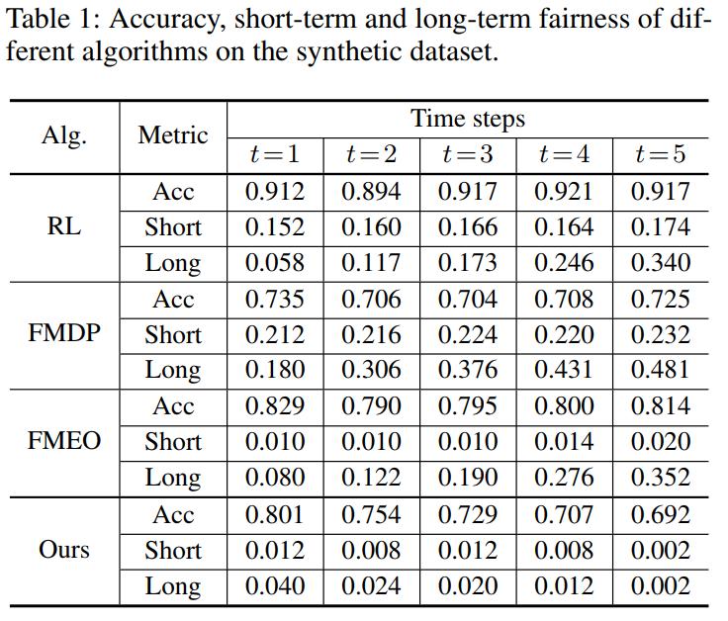
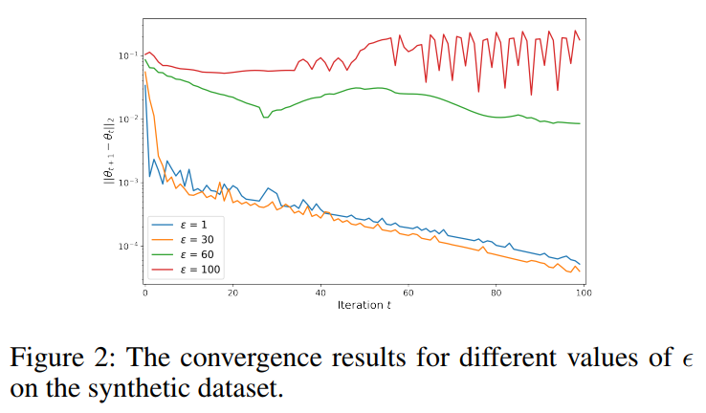
Experiments
Results of Synthetic Data:

Slide 26
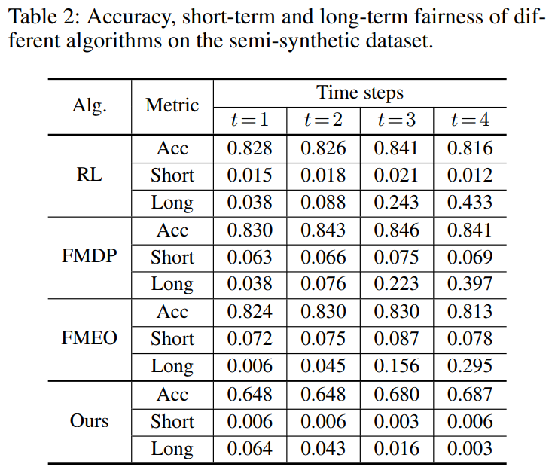
Experiments
Results of Semi-synthetic Data:

Slide 27
Conclusions
Proposed a framework to achieve long-term fairness in sequential decision making.
Measured both long-term and short-term fairness as path-specific effects in a time-lagged causal graph.
Formulated as a performative risk optimization problem, and repeated risk minimization is adopted to train the model on the datasets sampled from post-intervention distributions.
Theoretically analyzed the convergence of the proposed algorithm.
Conducted experiments on both synthetic and semi-synthetic datasets to show the effectiveness of the proposed framework and algorithm.

Slide 28



Achieving Long-term Fairness in Sequential Decision Making
Yaowei Hu
Lu Zhang
This work was supported in part by NSF 1910284, 1920920, and 1946391.

